Slide 1
Principles of Anatomy and Physiology
14th Edition
CHAPTER 4
The Tissue Level of Organization
Histology is the study of the tissues

Slide 2
Introduction
The purpose of this chapter is to discuss about:
All 4 types of tissues
their origins
their integrity
Compare and contrast epithelial, connective, muscular, and nervous tissue
tissue repair

Slide 3
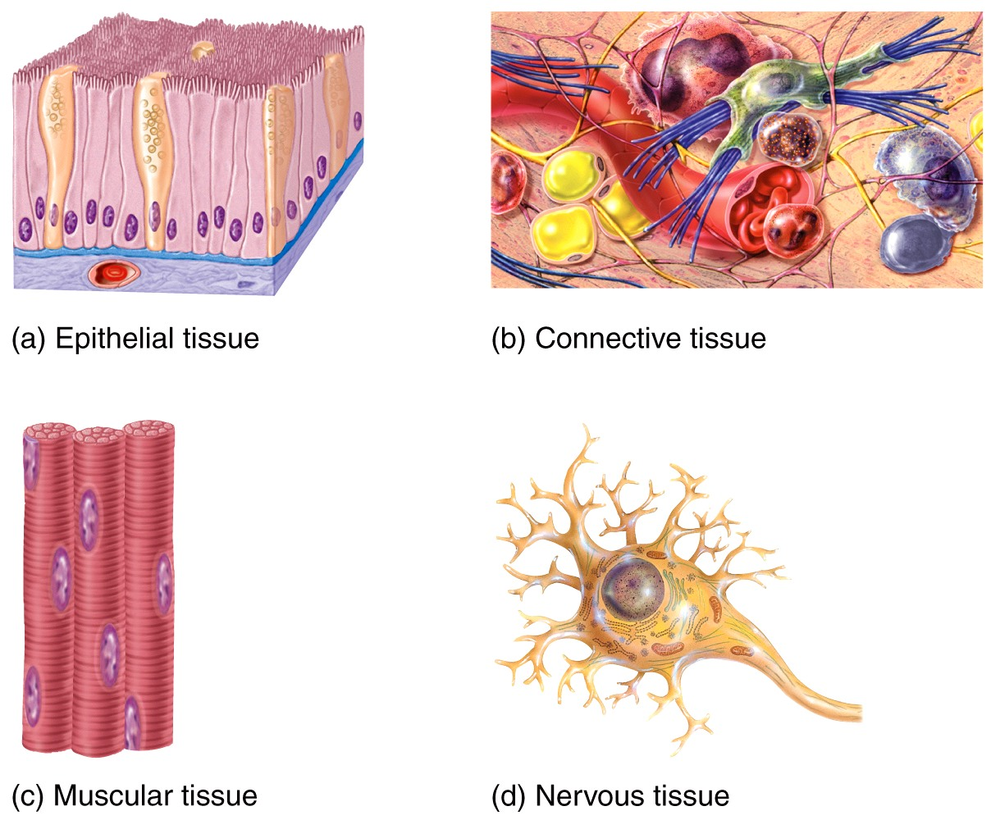
The 4 Tissue Types
Epithelial
Connective
Muscular
Nervous

Slide 4
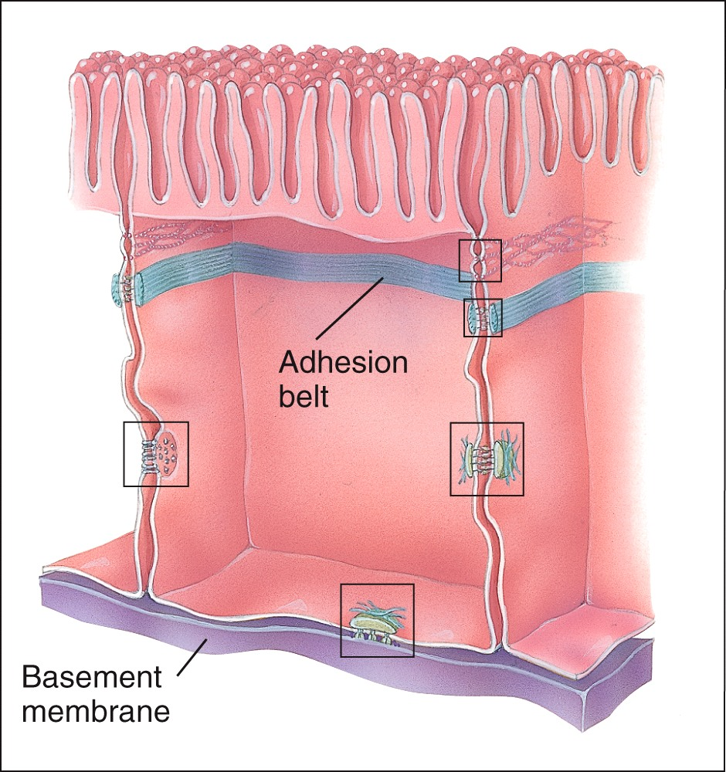
Cell Junctions
-points of contact between cells are called cell junctions.

Slide 5
Intercellular Junctions
Interactions Animation:
Intercellular Junctions
You must be connected to the Internet and in Slideshow Mode to run this animation.

Slide 6
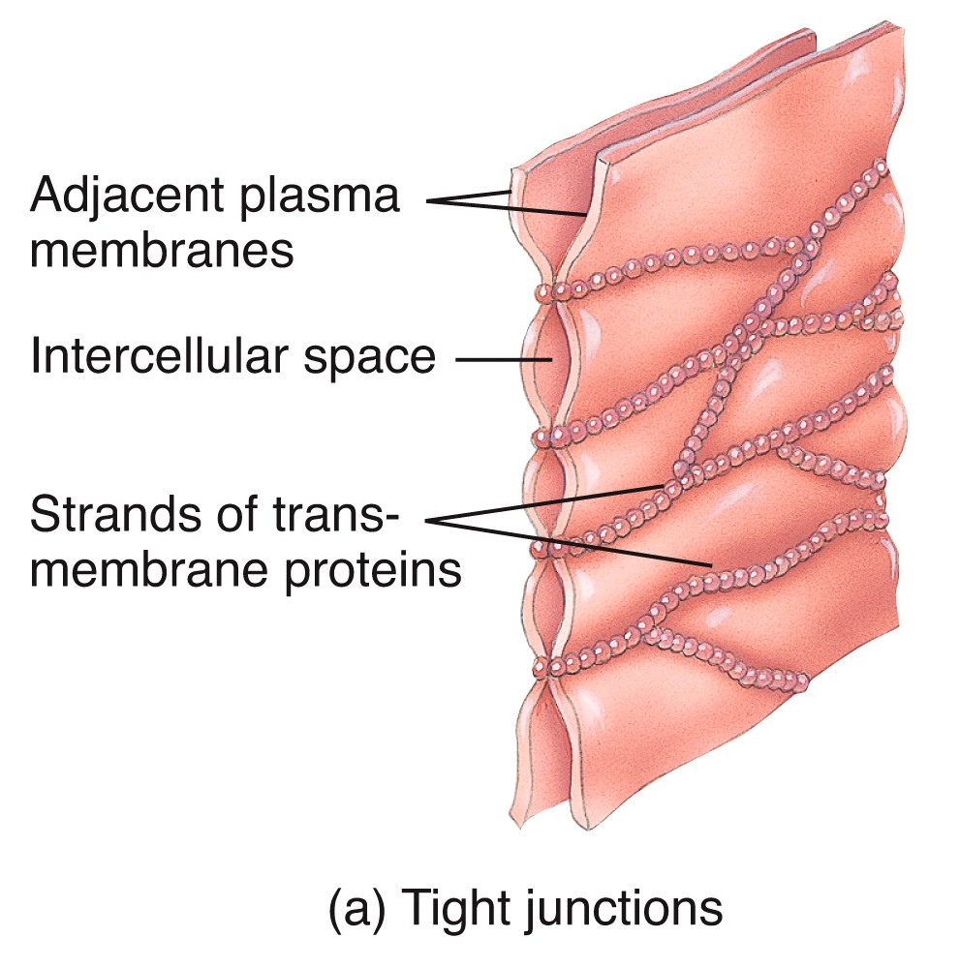
Tight Junctions

Slide 7
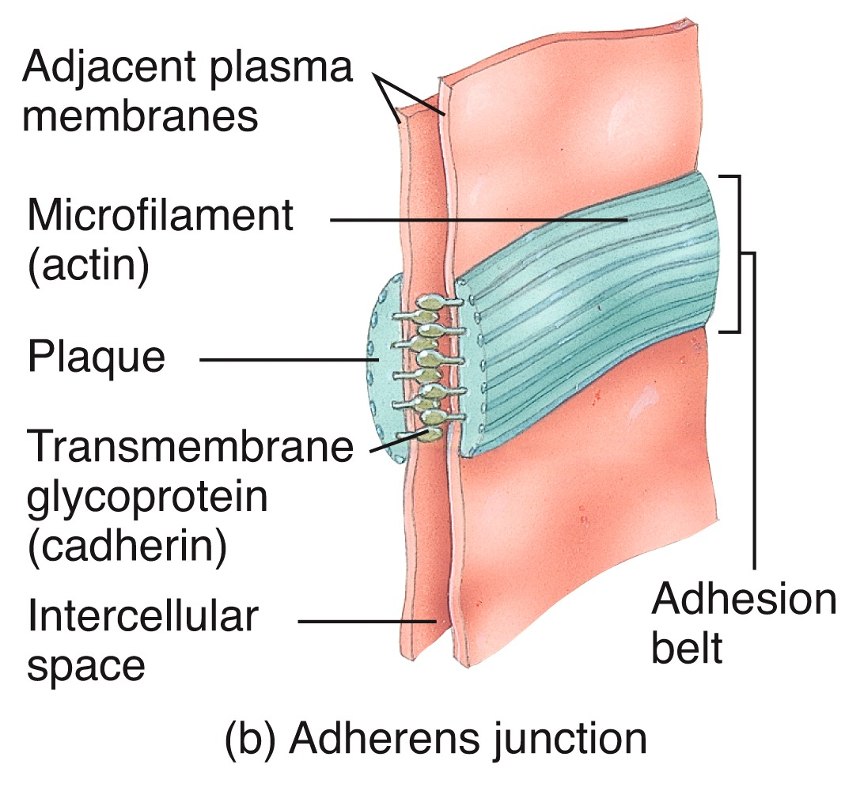
Adherens Junctions

Slide 8
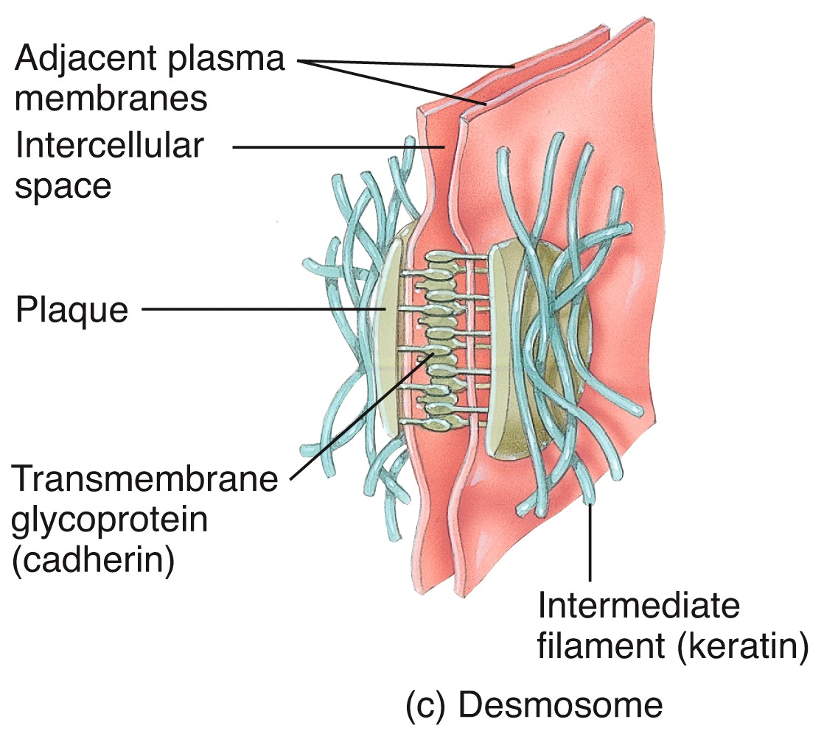
Desmosomes

Slide 9
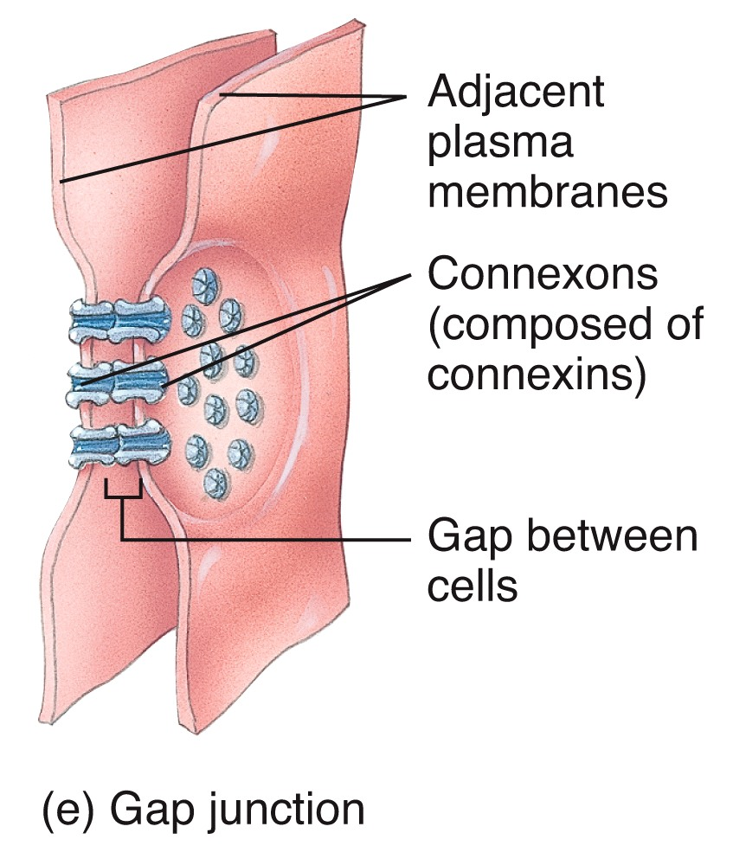
Gap Junctions

Slide 10
Epithelial Tissue
Cells are arranged in sheets
Cells are densely packed
Many cell junctions are present
Epithelial cells attach to a basement membrane
Epithelial tissue is avascular but does have a nerve supply
Mitosis occurs frequently

Slide 11
Epithelial Tissue
Anatomy Overview:
Epithelial Tissues
You must be connected to the Internet and in Slideshow Mode to run this animation.

Slide 12
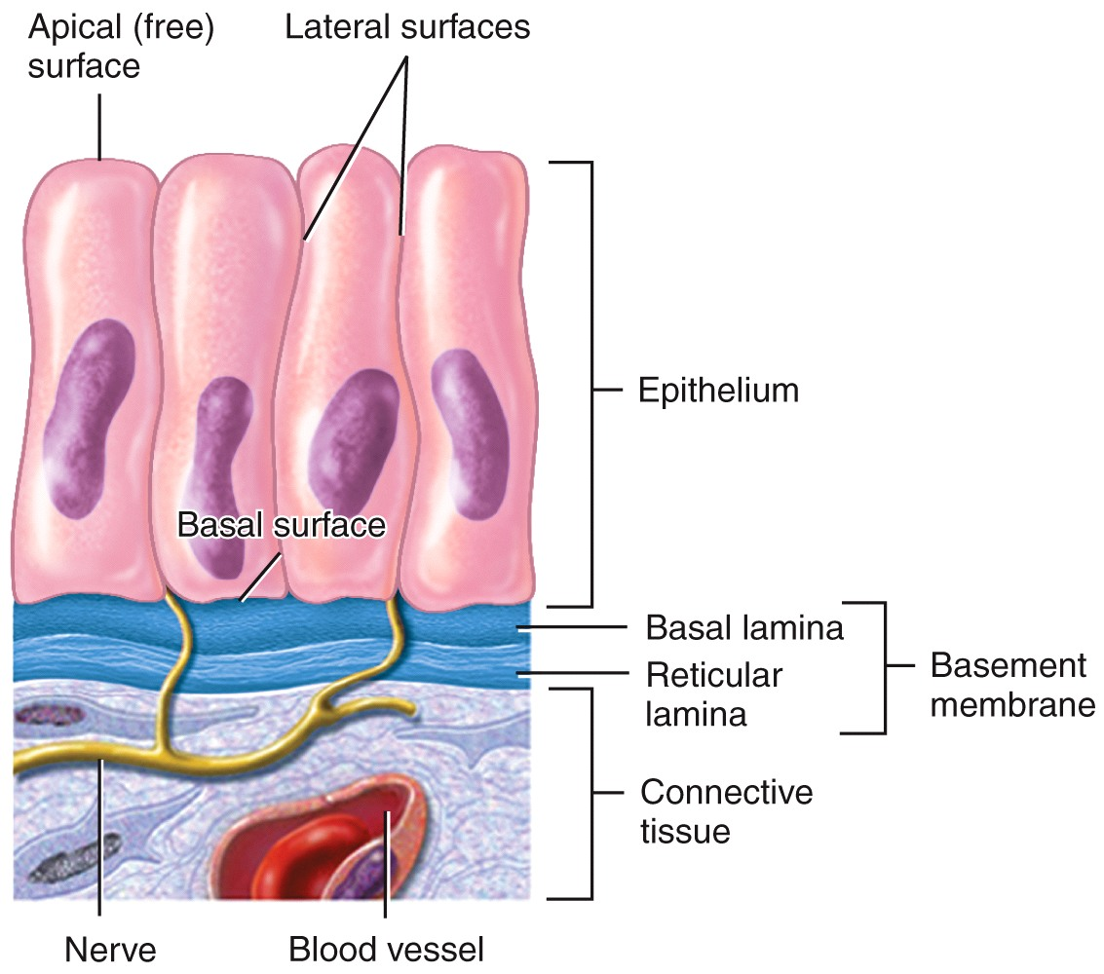
Surfaces of Epithelial Cells and the Basement Membrane

Slide 13
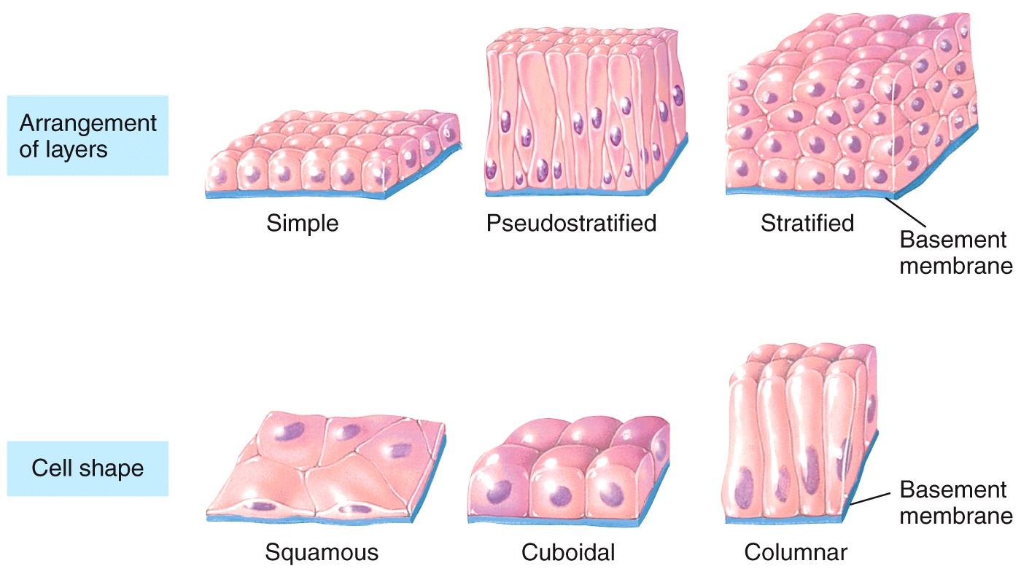
Classification of Epithelial Tissue
classified according to the shape of the cells and how many layers thick they are
the name of the specific type of stratified epithelial tissue depends on the shape of the apical cells

Slide 14
Epithelial Tissue Naming Combinations
 | Squamous | Cuboidal | Columnar
Simple | x | x | x
Pseudostratified |  |  | x
Stratified | x | x | x
Transitional

Slide 15
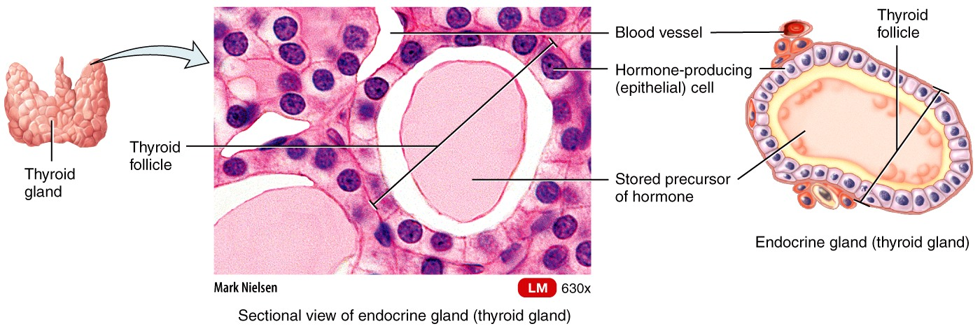
Glandular Epithelium (No)
A gland is a single cell or a mass of epithelial cells adapted for secretion
Endocrine vs. Exocrine Glands
$$$$$

Slide 16
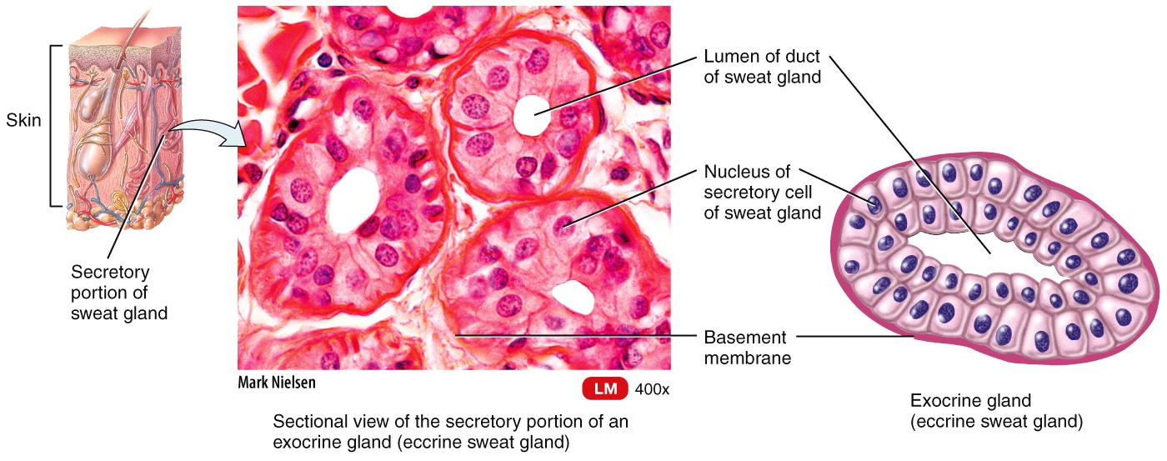
Glandular Epithelium (No)
A gland is a single cell or a mass of epithelial cells adapted for secretion
Endocrine vs. Exocrine Glands

Slide 17
Structural Classification of Glandular Epithelium (No)
Unicellular – single cells
Multicellular – composed of many cells that form a distinctive microscopic structure or macroscopic organ
Sweat glands
Oil glands
Salivary glands

Slide 18
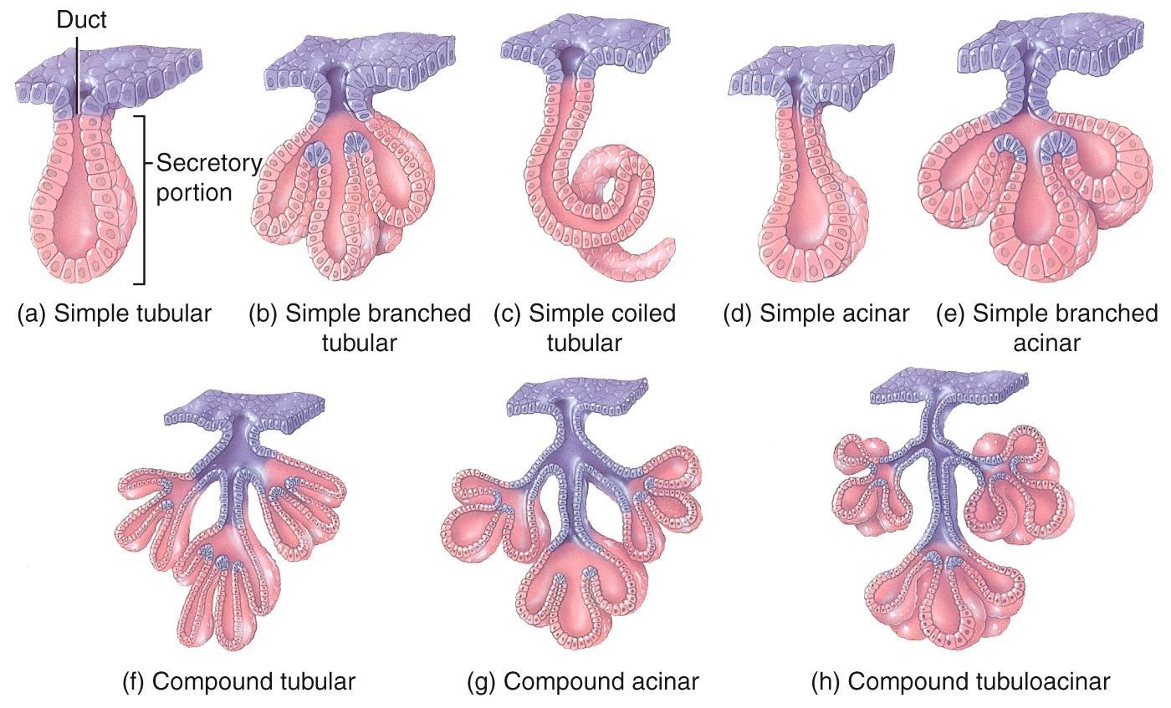
(No)

Slide 19
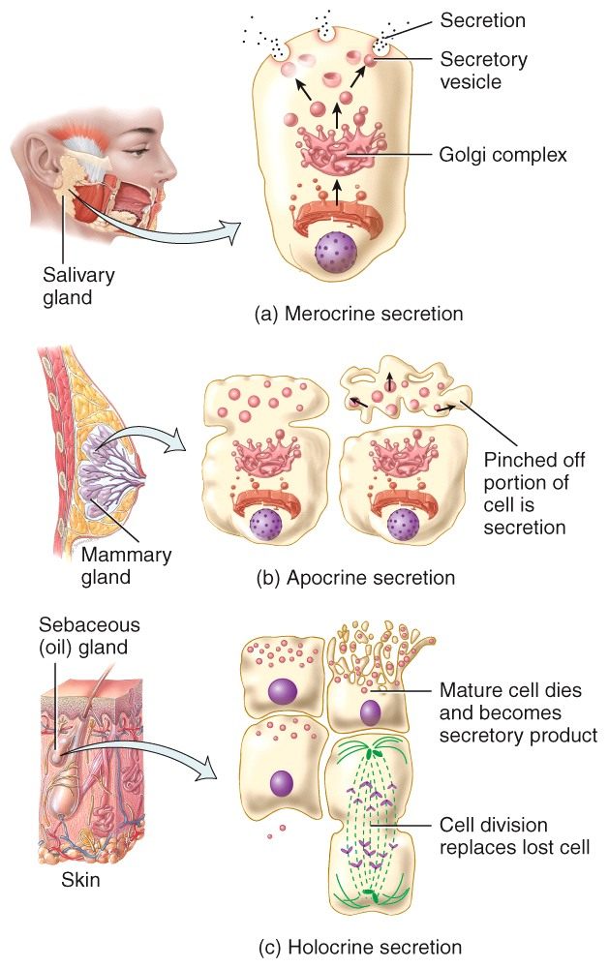
Functional Classification of Glandular Epithelium upon their mode of secretion:
Merocrine
Apocrine
Holocrine

Slide 20
Connective Tissue
Consists of two basic elements
Cells
Important Extracellular matrix
Epithelial Connective tissue is highly vascularized and has nerve supply
Except tendon and cartilage????

Slide 21
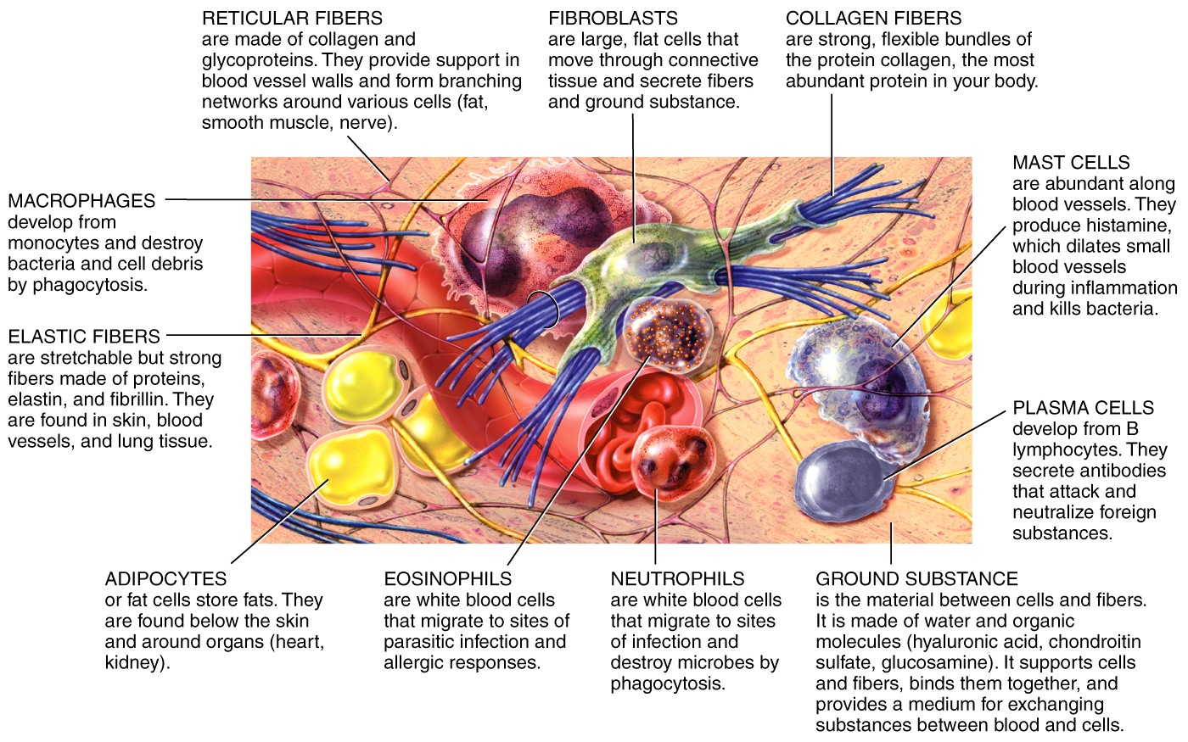
Connective Tissue Cells

Slide 22
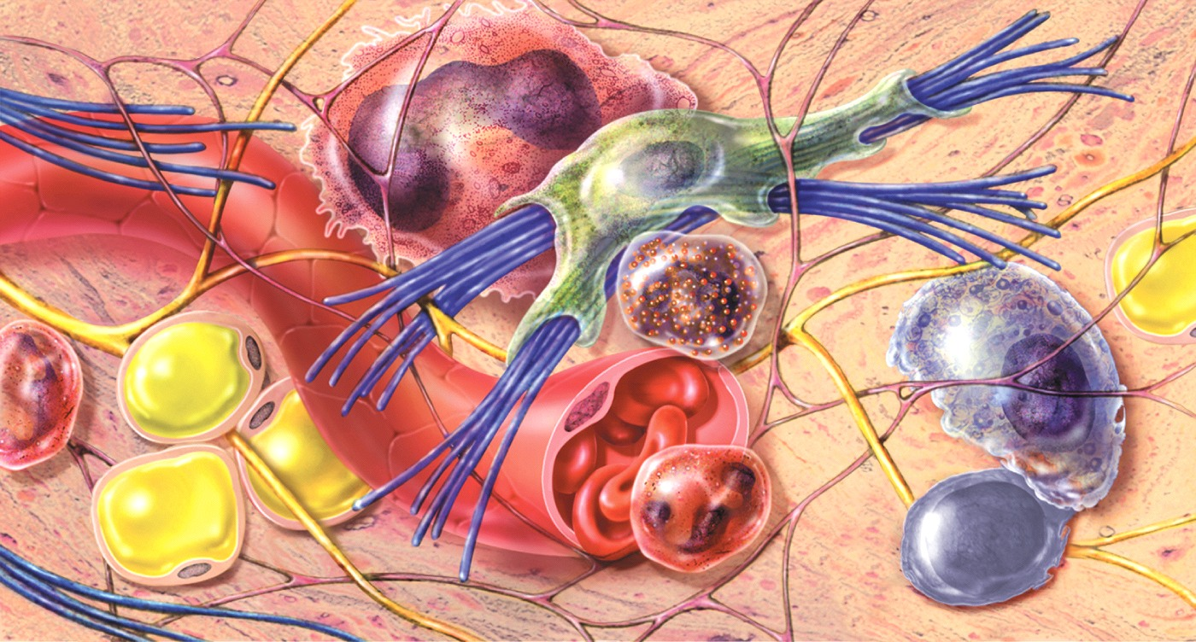
Connective Tissue Extracellular Matrix
Extracellular matrix is the spaces between connective tissue cells
Extracellular matrix is composed of:
Fibers
Ground substance

Slide 23
Connective Tissue Fibers
in the extracellular matrix provide strength and support
Collagen fibers
Elastic fibers
Reticular fibers

Slide 24
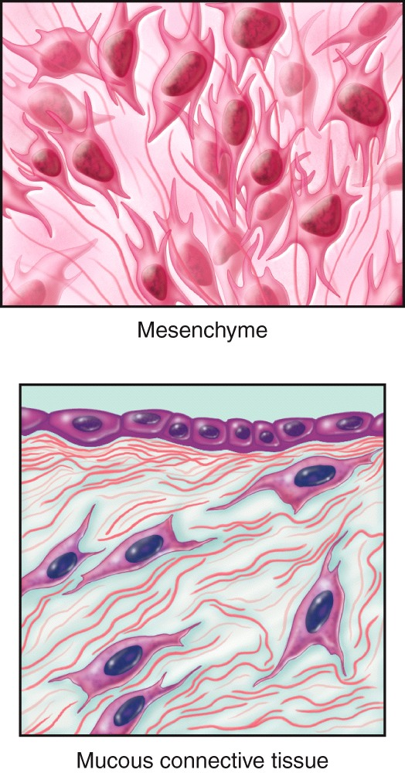
Classification of Connective Tissue
Depends on its Embryonic origin: mesoderm/ectoderm
Mesenchymatous
Mucous

Slide 25
Classification of Connective Tissue
Loose
Dense
Types of connective tissue:
Cartilage
Bone
Adipose
Blood

Slide 26
CONNECTIVE TISSUES

Slide 27
Connective Tissue
Anatomy Overview:
Connective Tissues
You must be connected to the Internet and in Slideshow Mode to run this animation.

Slide 28
Membranes( your book/ppt has mistakes here)
Membranes are thin sheets of pliable tissue that cover or line a part of the body
2 types of membranes
Epithelial membranes
Mucous membranes
Serous membranes
Connective Tissue Membranes
Synovial
Meninges

Slide 29
MEMBRANES
https://training.seer.cancer.gov/anatomy/cells_tissues_membranes/membranes.html

Slide 30
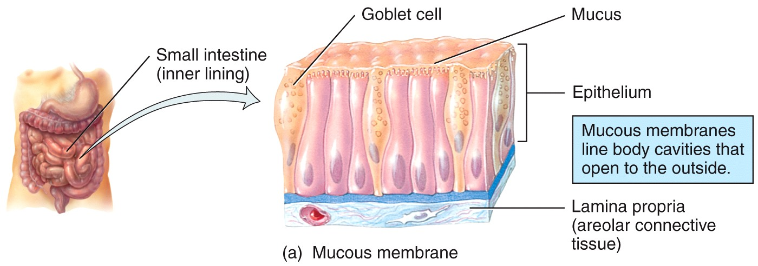
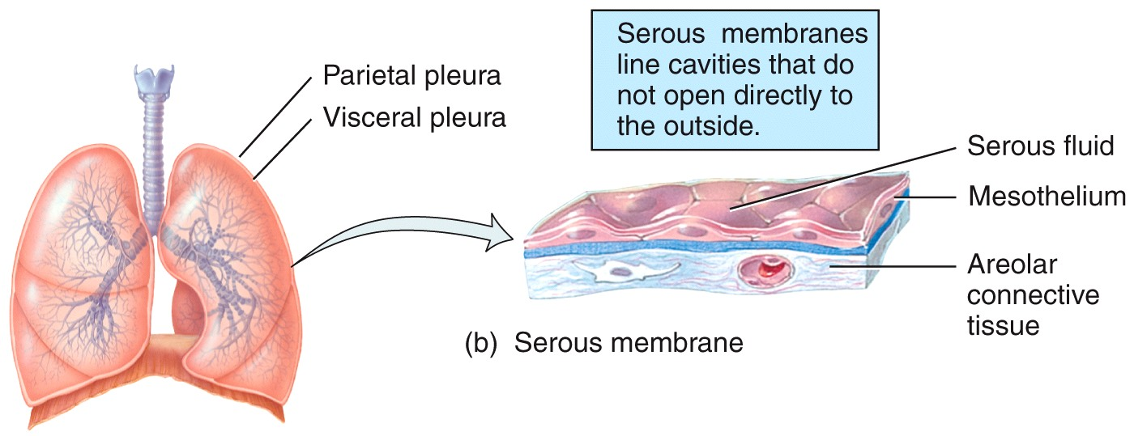

Slide 31
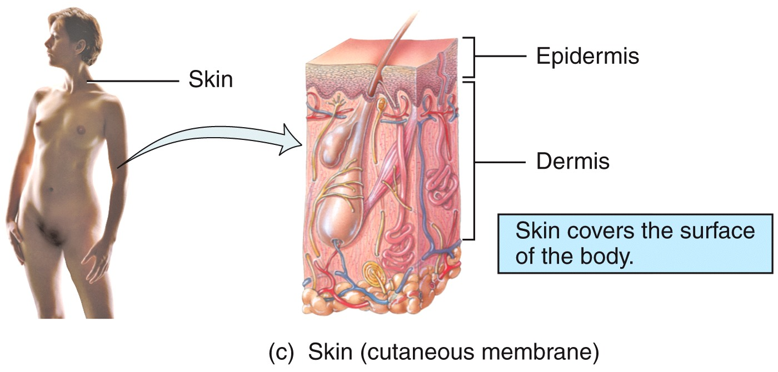

Slide 32
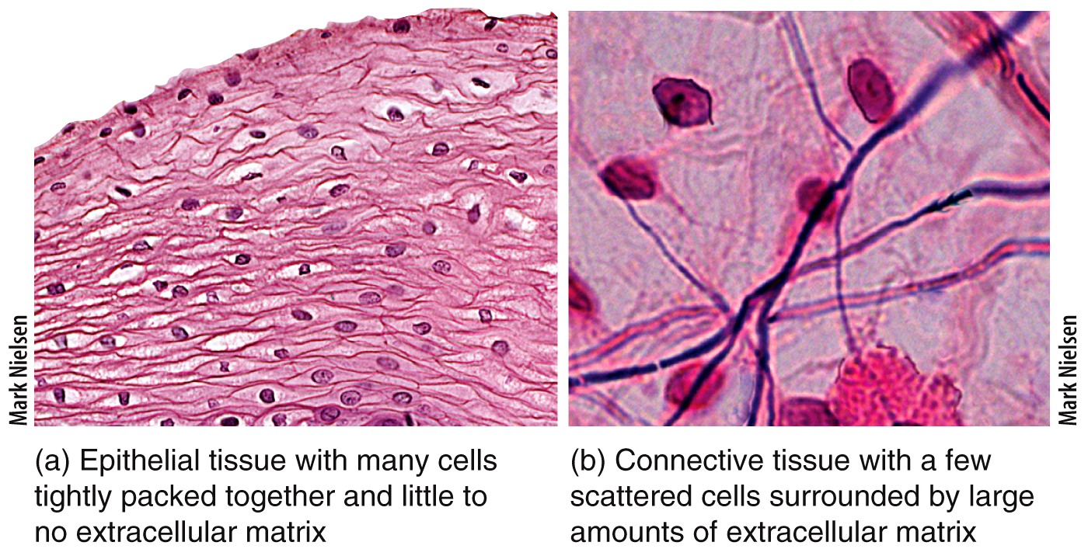
Epithelial vs. Connective Tissue
What differences can you see?

Slide 33
General Characteristics of Muscular Tissue
Muscle tissue consists of fibers that are able to contract
3 types of muscle tissue
Skeletal muscle
Cardiac muscle
Smooth muscle

Slide 34
Muscle Tissue
Anatomy Overview:
Muscle Tissue
You must be connected to the Internet and in Slideshow Mode to run this animation.

Slide 35
General Characteristics of Nervous Tissue
Two kinds of cells:
Neurons
Neuroglia Neuroglial cells or Glial Cells (Glue)
neurons have
cell body,
dendrites,
and ONE axons They carry sensory and motor information and perform integrative functions.
they carry electrical impulses
Neuroglia protect and support neurons

Slide 36
Nervous Tissue
Anatomy Overview:
Nervous Tissue
You must be connected to the Internet and in Slideshow Mode to run this animation.

Slide 37
Tissue Repair, Aging, and Disorders

Slide 38
Tissue Repair
Tissue repair is the process that replaces worn out, damaged, or dead cells.
Epithelial cells are replaced by the division of stem cells or undifferentiated cells
Not all connective tissue cells have the ability to repair
Muscle cells can perform limited repair
Some nervous cells= glial cells can perform limited repair, others cannot
http://www.ncbi.nlm.nih.gov/pmc/articles/PMC2941225/
Fibrosis is the formation of scar tissue

Slide 39
Aging
Younger bodies generally experience:
A better nutritional state
A better blood supply to tissues
A faster metabolic rate
Aging slows the process of tissue repair

Slide 40
Disorders
Disorders of epithelial tissues tend to be specific to individual organs
Skin cancer
Disorders of connective tissues tend to be autoimmune in nature
Lupus
Disorders of muscular and nervous tissues will be discussed in later chapters

