Slide 1
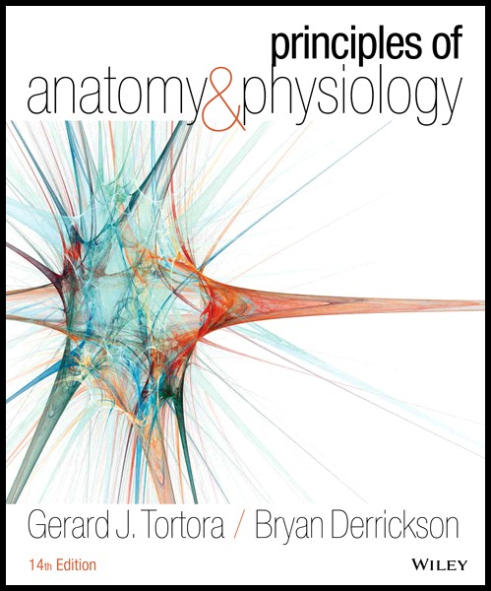
Principles of Anatomy and Physiology
14th Edition
CHAPTER 5
The Integumentary System
Modified by dr. C. Gerin

Slide 2
Introduction
The organs of the integumentary system:
skin
accessory structures: hair, nails, and glands, (blood vessels, muscles and nerves).

Slide 3
Introduction
The integumentary system roles:
thermoregulation and homeostasis
Converts inactive vitamin D to its active form
Provides sensory information

Slide 4
Structures of the Skin
The skin has 3 major layers:
The outer is called the epidermis (epithelium)
The inner is called the dermis
The subcutaneous (subQ) layer (also called the hypodermis) is located underneath the dermis.

Slide 5
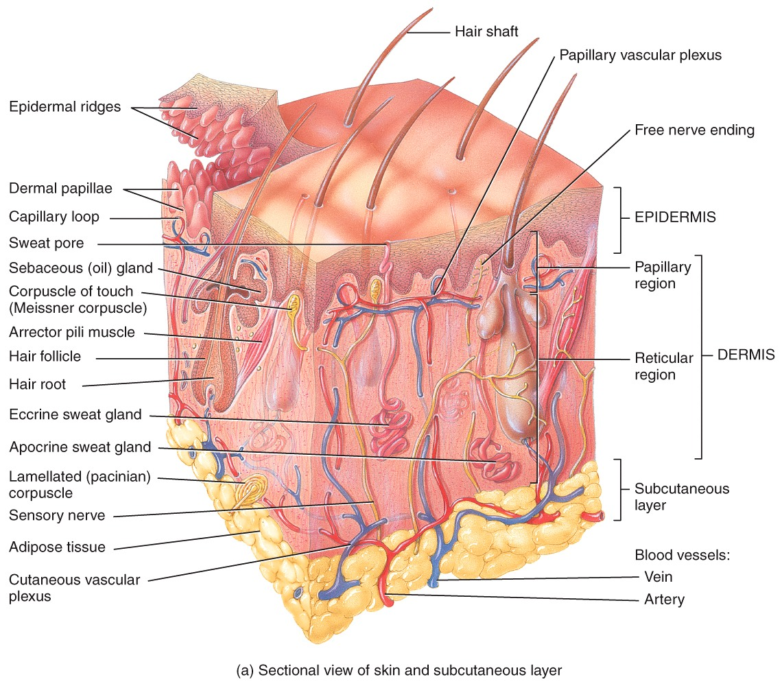
Structures of the Skin

Slide 6
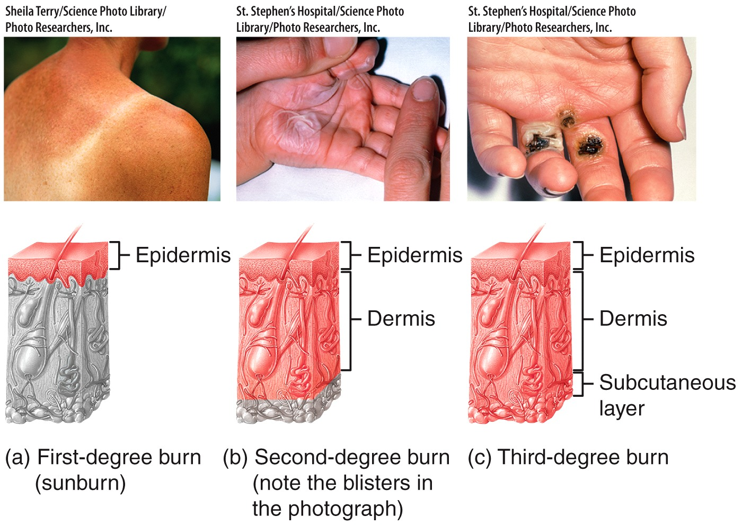
Structures of the Skin
Dermatologist are doctors who treat disorders of all layers of the integumentary system.

Slide 7
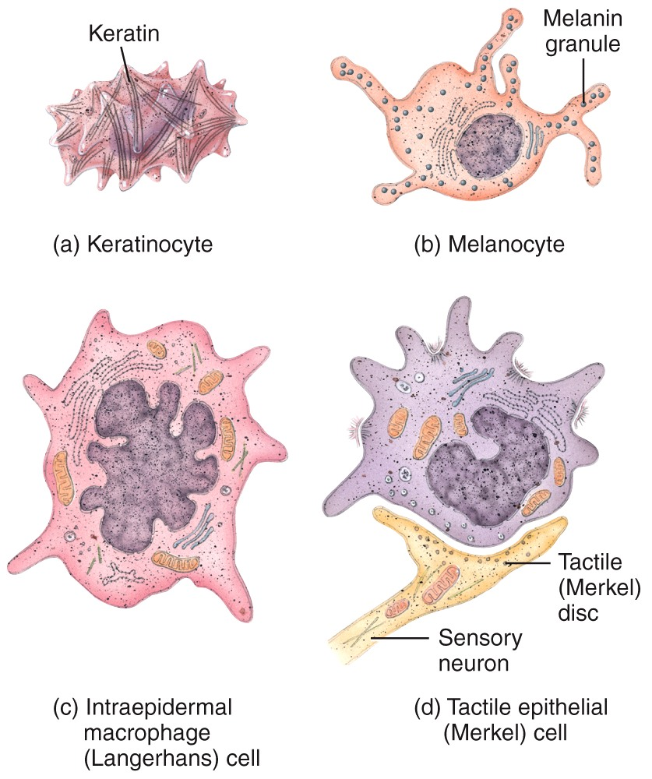
The Epidermis (epithelium of the integumentary)
Contains four major types of cells:
Keratinocytes
Melanocytes
Intraepidermal macrophages
Tactile epithelial cells (Merkel disc)

Slide 8
The Epidermis
Keratinocytes produce keratin - a tough fibrous protein that provides protection.
Melanocytes produce the pigment melanin
Intraepidermal macrophages are involved in the immune responses.
Tactile epithelial cells function in the sensation of touch.

Slide 9
The Epidermis
The epidermis is composed of four layers in thin skin, and five layers in thick skin. They are (from deep to superficial):
The stratum basale
The stratum spinosum
The stratum granulosum
The stratum lucidum (only present in thick skin)
The stratum corneum

Slide 10
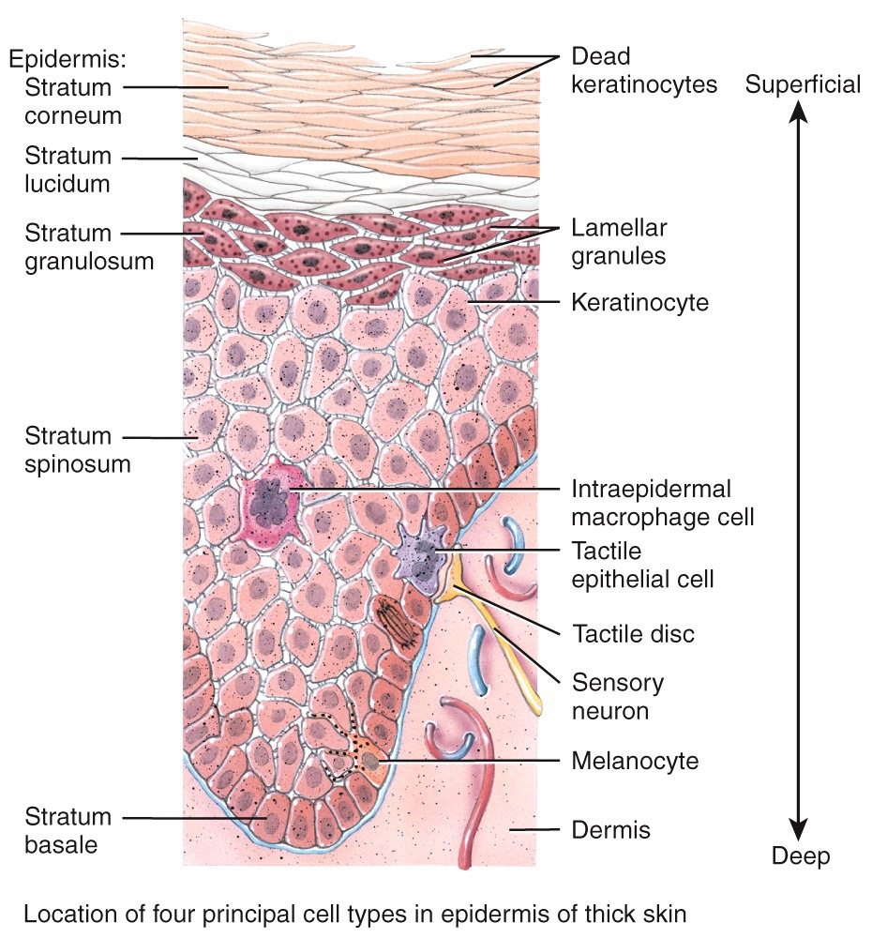
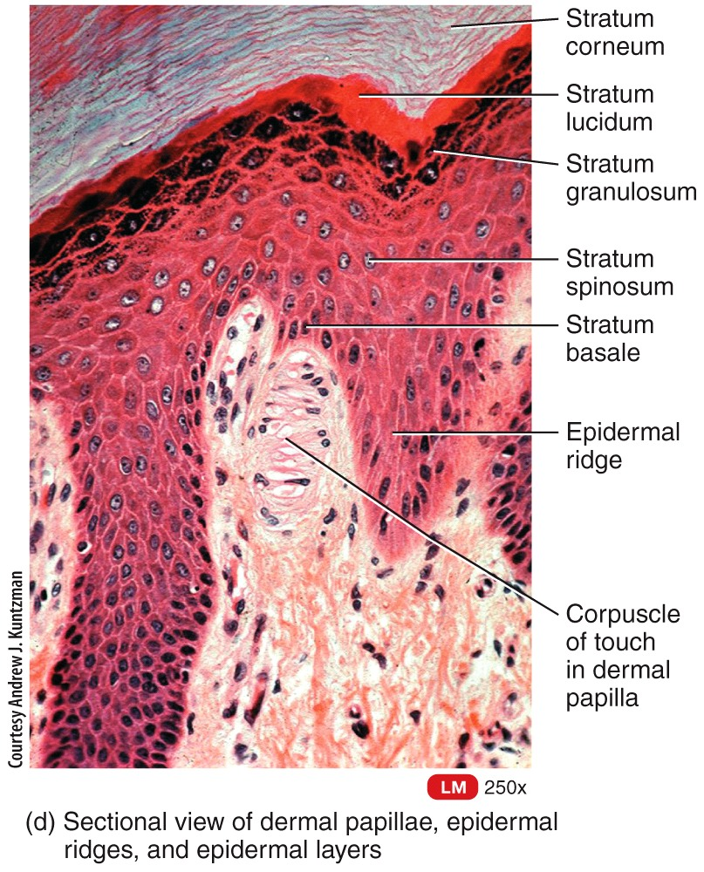
The Epidermis

Slide 11
The Epidermis
Types of skin:
Thin (hairy) skin covers all body regions except the palms, palmar surfaces of digits, and soles.
Thick (hairless) skin covers the palms, palmar
surfaces of digits, and soles, ungual phalanges

Slide 12
The Epidermis
Skin Pigments
Melanin is produced by melanocytes in the stratum basale
Notes:
Melanin is a class of compounds found in plants and animals where it serves predominantly as a pigment. The class of pigments are derivatives of the amino acid tyrosine. The most common form of biological melanin is eumelanin, a brown-black polymer of dihydroxyindole carboxylic acid, and their reduced forms. Another common form of melanin is pheomelanin, a red-brown polymer of benzothiazine units largely responsible for red hair and freckles

Slide 13
The Epidermis
Skin Pigments
Albinism:
congenital disorder
complete or partial absence of pigment :
skin, hair, and eyes
due to a defect of an enzyme involved in the production of melanin.

Slide 14
The Epidermis
Skin Pigments
Vitiligo is a chronic depigmentation of skin
cause unknown

Slide 15
The Dermis : Connective Tissue
The dermis is composed of connective tissue containing collagen and elastic fibers.
It contains two regions:
The papillary region lies just below the epidermis
The reticular region consists of dense irregular connective tissue

Slide 16
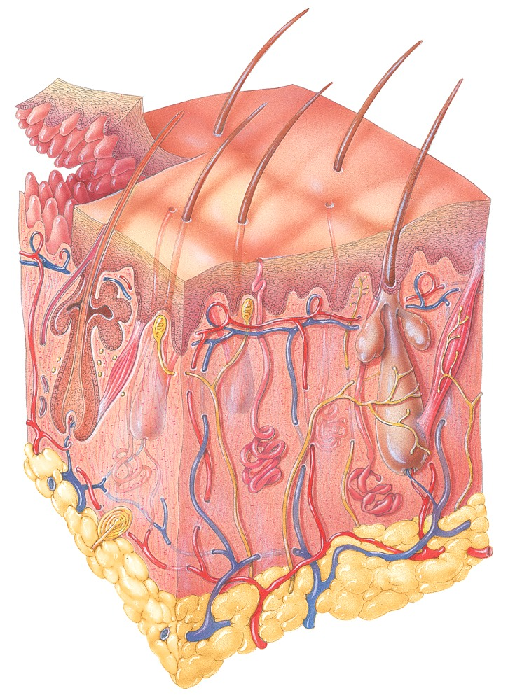
The Subcutaneous Layer
subcutaneous layer = hypodermis
attaches the skin to underlying tissues and organs.
fat
subQ

Slide 17
Innervation of the skin = Sensory Receptors
The skin contains different types of sensory receptors found in different layers:
Superficially
Type I cutaneous mechanoreceptors, free nerve endings, corpuscles of touch and hair root plexuses
Deep
Lamellated corpuscles

Slide 18
Sensory Receptors
Notes:
05_01a

Slide 19
Hair
Present on most surfaces except the palms, anterior surfaces of fingers, and the soles of the feet.
Composed of dead, keratinized epidermal cells.
Genetics determines thickness and distribution.

Slide 20
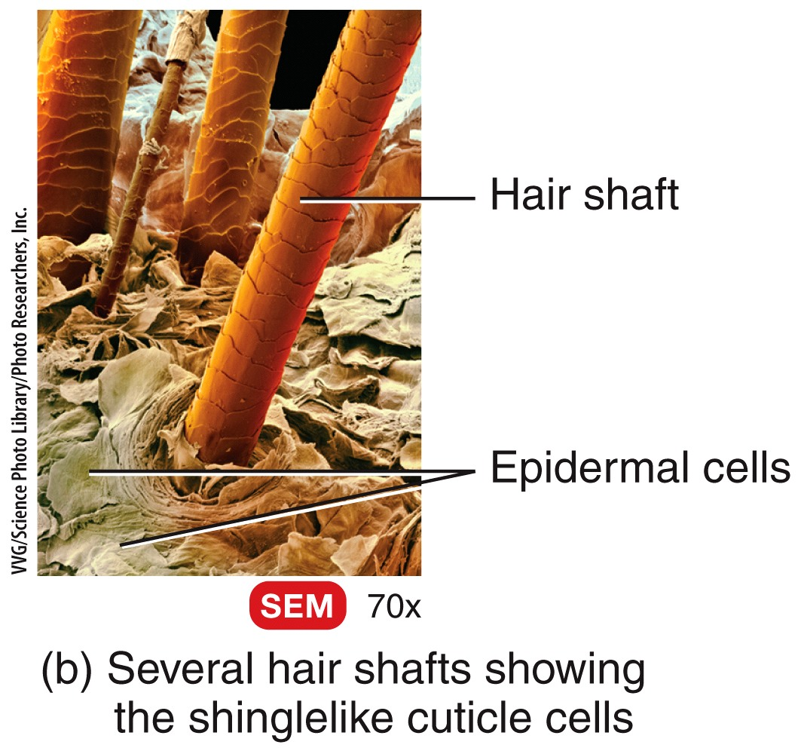
Hair
The parts of a hair include:
shaft (above the skin surface)
follicle (below the level of the skin)
root that penetrates into
the dermis includes:
An epithelial root sheath
A dermal root sheath

Slide 21
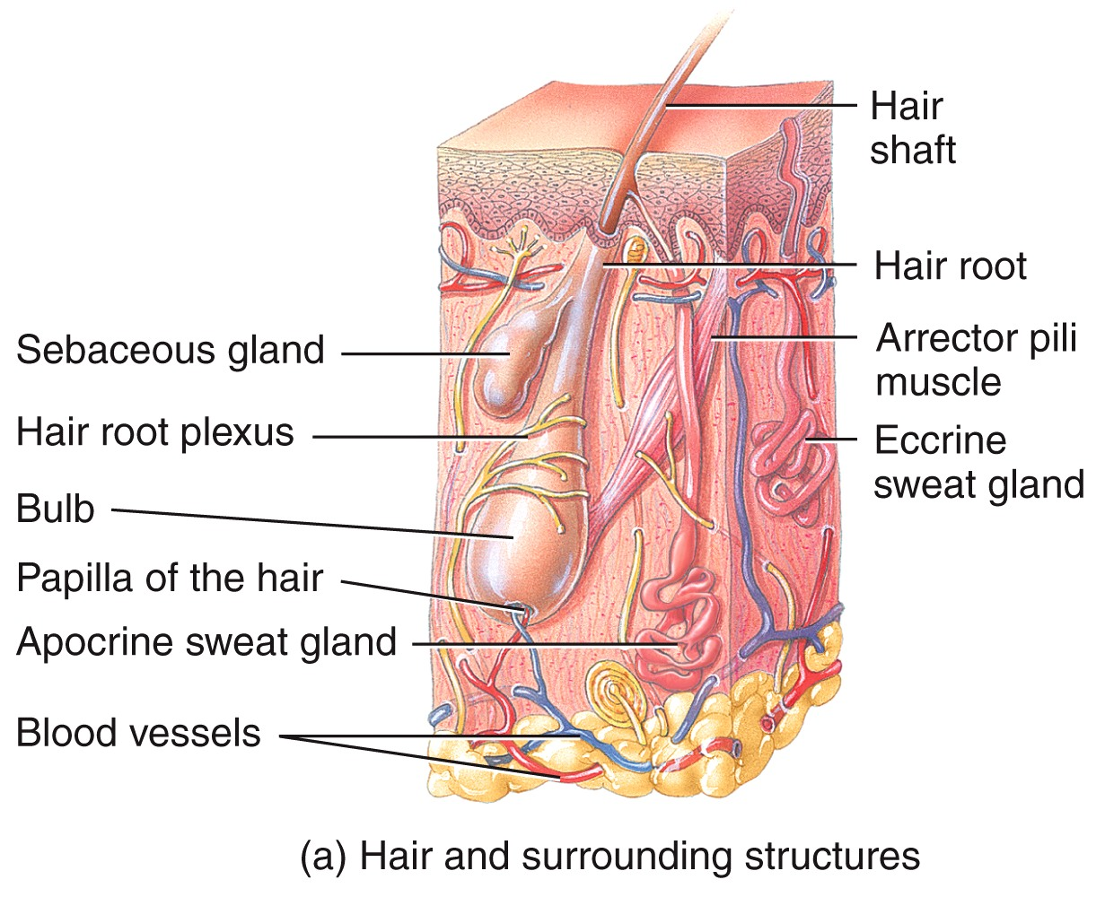
Hair

Slide 22
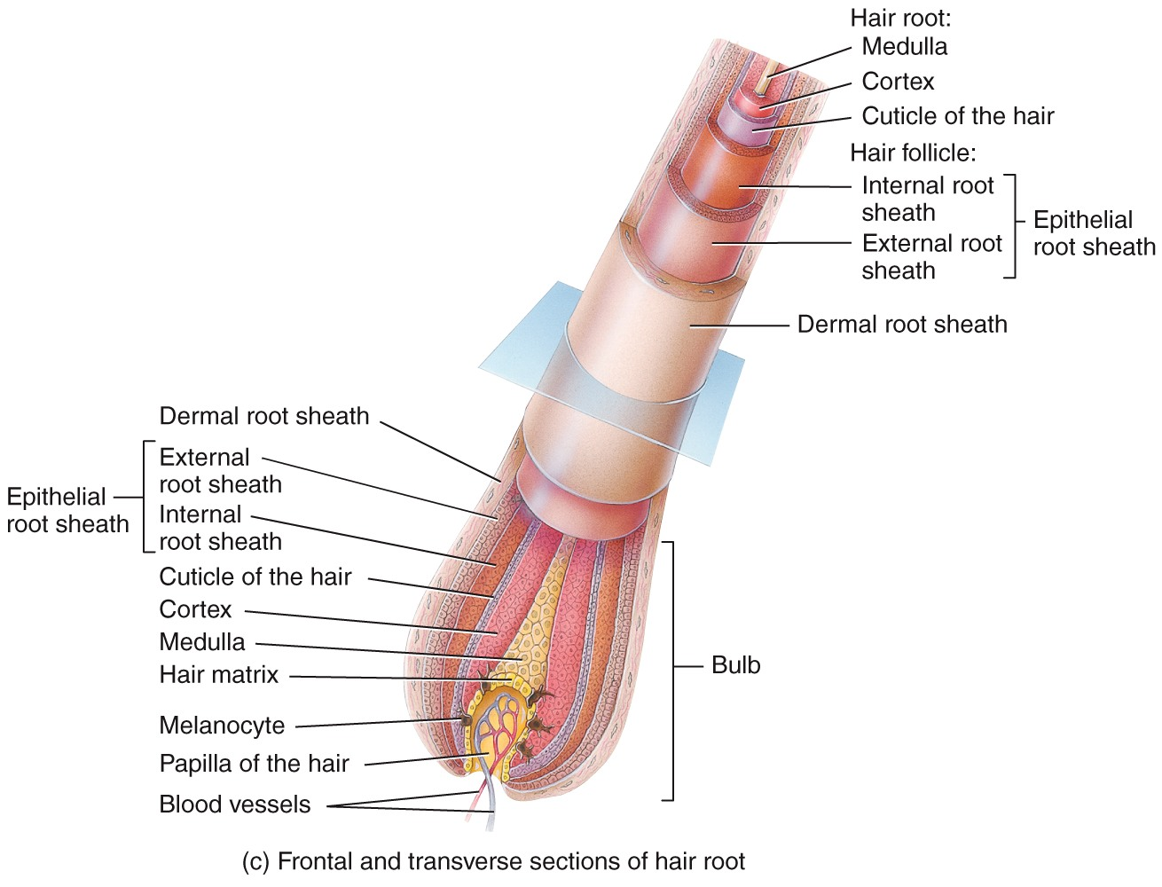
Hair

Slide 23
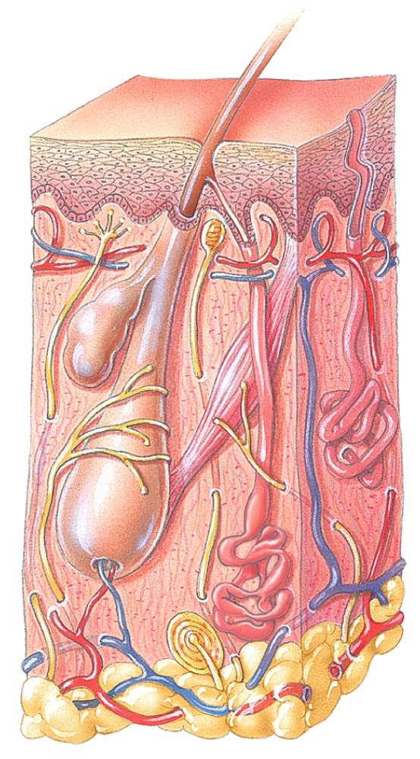
Skin Glands
The skin contains 4 types of glands.
Sebaceous (oil) glands are connected to hair follicles.
Eccrine sweat glands are the most numerous.
Apocrine sweat glands are located mainly in hairy skin.
Ceruminous glands are modified sweat glands located in the ear canal.

Slide 24
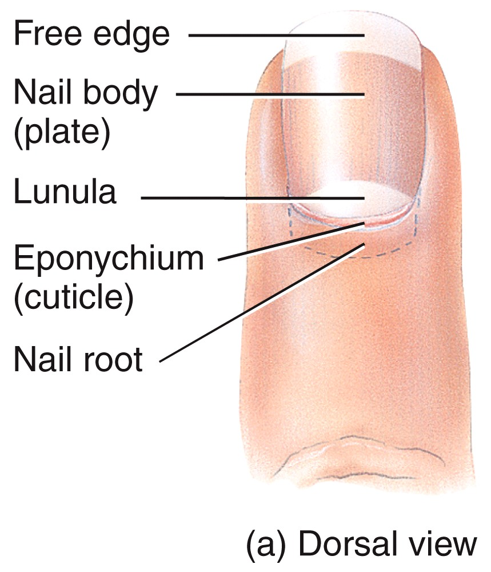
Nails
Made of keratinized epidermal cells
Nail structures include:
Free edge
Transparent nail body (plate)
with a whitish lunula at its
base
Nail root embedded in a
fold of skin

Slide 25
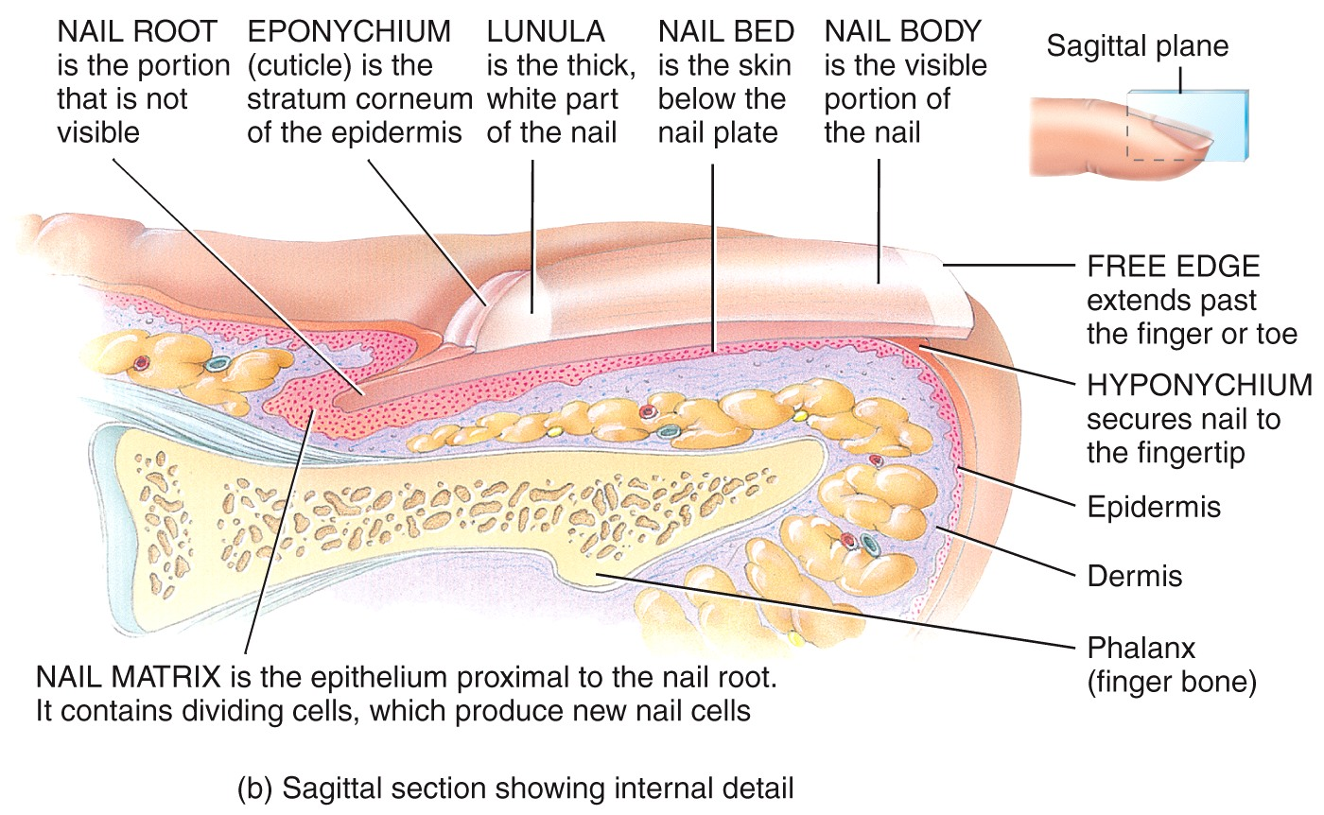
Nails

Slide 26
The Integumentary System
Anatomy Overview:
The Integumentary System
You must be connected to the Internet and in Slideshow Mode to run this animation.

Slide 27
Wound Healing
depending on the depth of the injury.
Epidermal wound healing occurs following superficial wounds that affect only the epidermis.

Slide 28
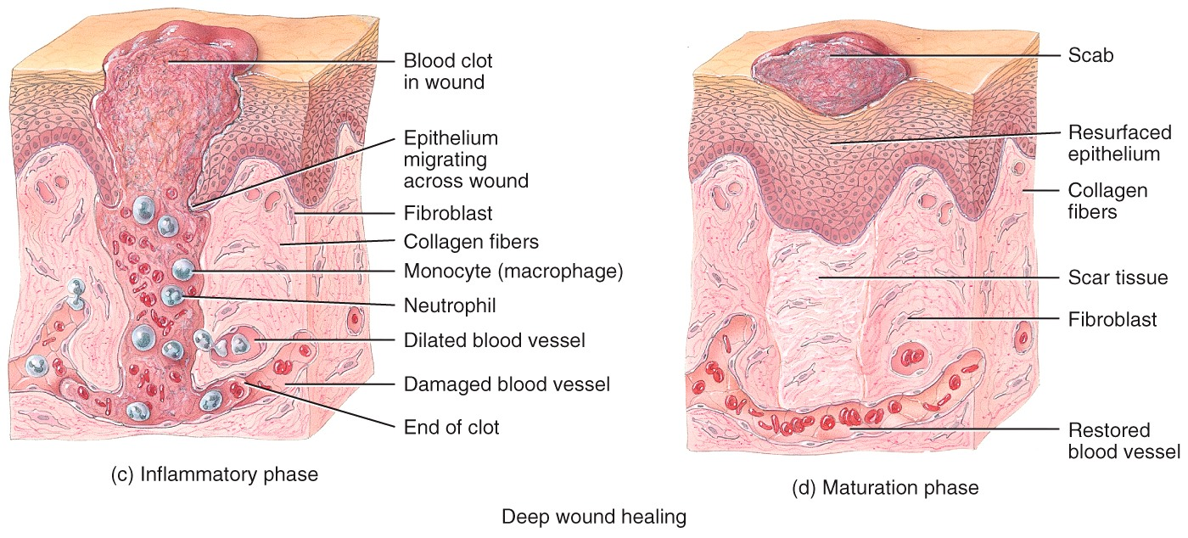
Wound Healing
Deep wound healing occurs when an injury extends to the dermis and subcutaneous layer.

Slide 29
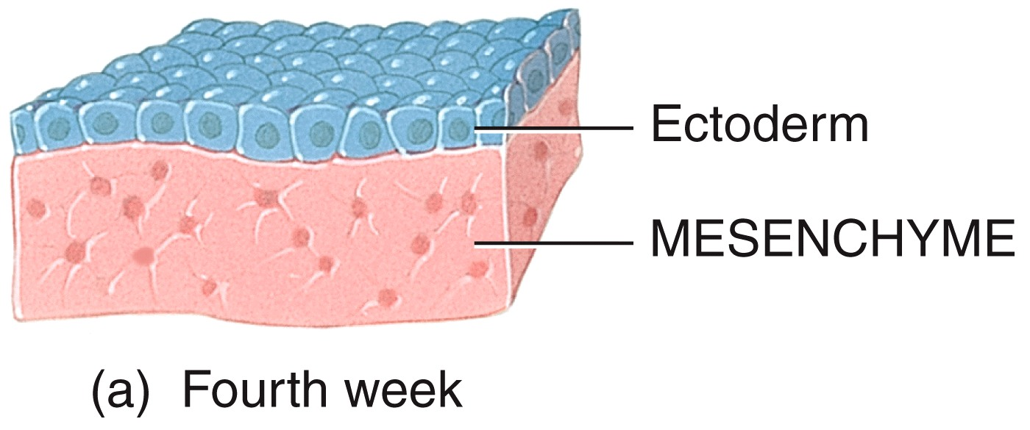
Development of the Integumentary System
The epidermis develops from the ectoderm*.
Nails, hair, and skin glands are epidermal derivatives appendages.
Mesoderm (=>Mesenchyme)
Notes:
Check wikipedia for the term: mesoderm (OK)

Slide 30
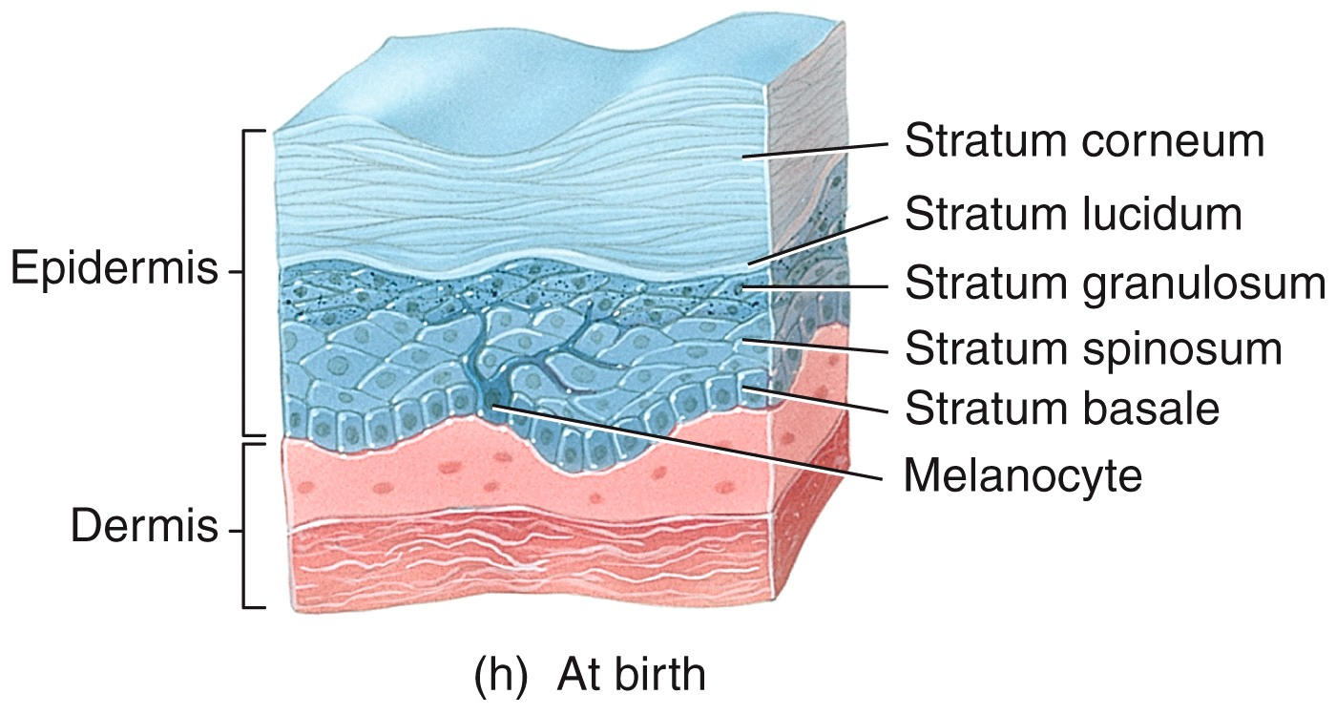
Development of the Integumentary System
The dermis develops from the mesoderm.

Slide 31
Aging
The integumentary system changes with age:
Wrinkles develop.
Dehydration and cracking occurs.
Sweat production decreases.
decrease in the numbers of functional melanocytes results in gray hair and atypical skin pigmentation.
Subcutaneous fat decreases, and there is a general decrease in skin thickness.
Nails/ (hair) may also become more brittle (lack of cystein for sulfur bonds of the keratine.

Slide 32
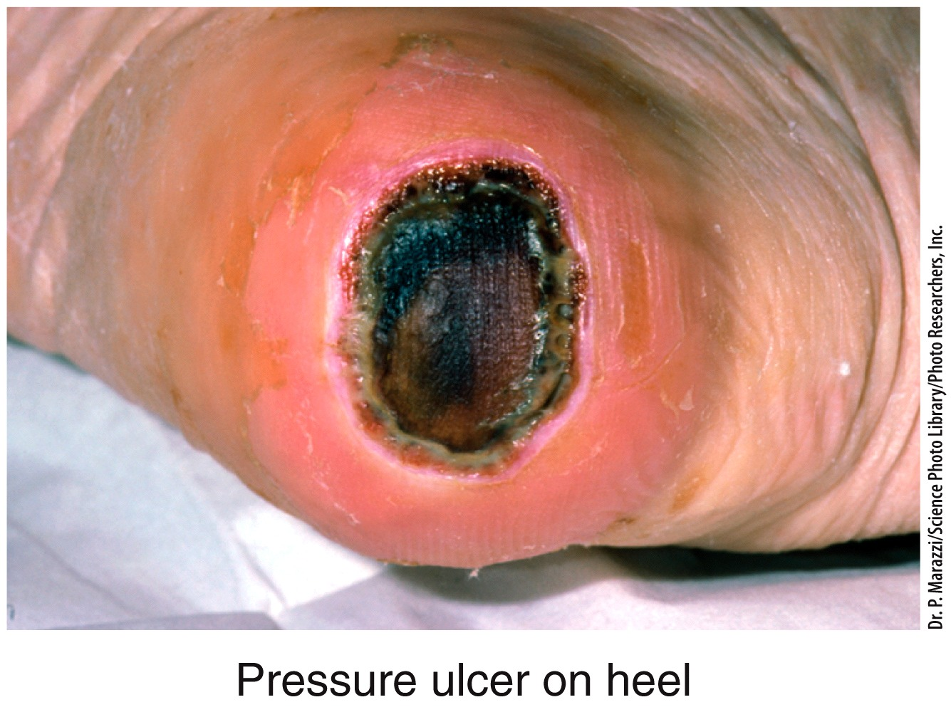
Aging
With age=> bc of less muscle and fat but can be any age , there is also an increased susceptibility to pressure ulcers (“bed sores”).

Slide 33
Skin Cancer
Excessive exposure to ultraviolet light (from the sun or tanning salons) is the most common cause of skin cancer. The three major types are
squamous cell carcinoma (common, epithelium, keratin , sun+ fair skin + age, human papilloma virus, metastasis risk ± at 10 yrs
basal cell carcinoma (most common, low metastatic -),
melanoma from melanocytes ( less common, metastatic 17% survival at 5 years when spread).

Slide 34
The three major types are
squamous cell carcinoma (common, epithelium, keratin , sun+ fair skin + age, human papilloma virus, metastasis risk ± at 10 yrs
basal cell carcinoma (most common, low metastatic -),
melanoma from melanocytes ( less common, metastatic 17% survival at 5 years when spread).
CARCINOMA: cancer of epithelial cells
Sarcoma: mesoderm => mesenchyme non- hematopoietic
Blood Cancer: mesoderm hematopoietic (includes Leukemia, lymphoma,….)

Slide 35
Burns
A burn is tissue damage caused by excessive heat, electricity, radioactivity, or corrosive chemicals that denature (break down) the proteins in the skin cells (tertiary (vdW), 2ndary (hydrogen), 1ary (peptide covalent) stucture).
Burns are graded according to their severity.

Slide 36
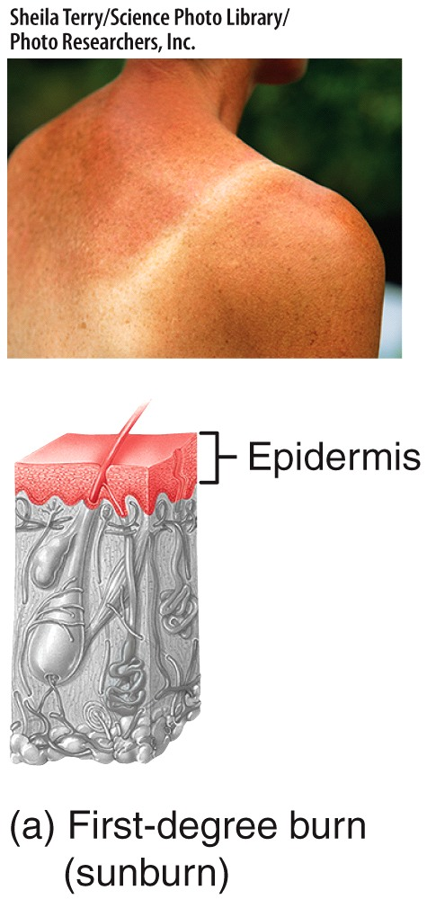
Burns
A first-degree burn involves only the epidermis (sunburn).

Slide 37
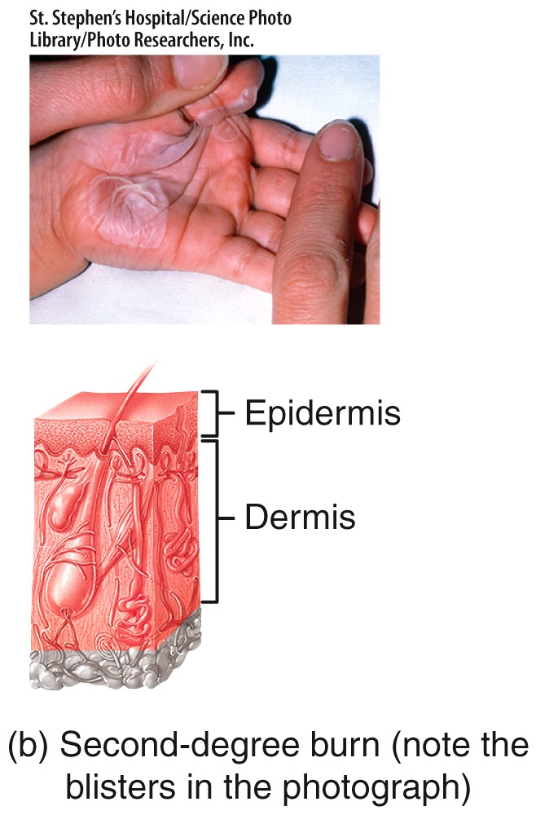
Burns
A second-degree burn destroys the epidermis and part of the dermis (blister).

Slide 38
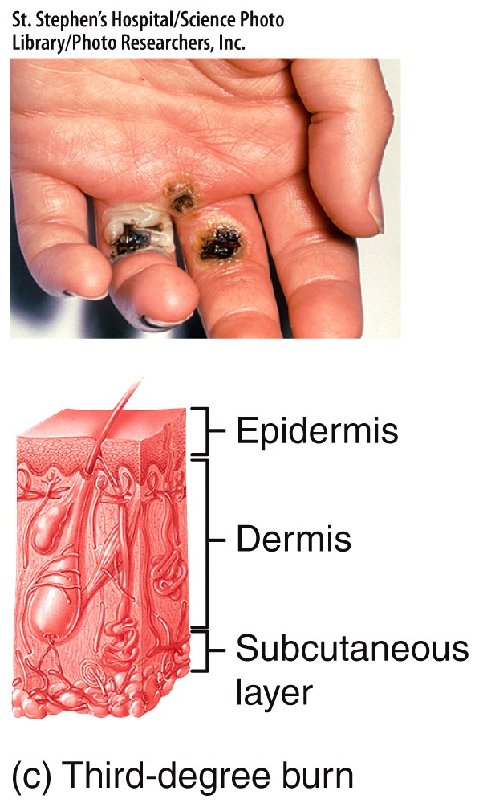
Burns
A third-degree burn is a full-thickness burn (destroys the epidermis, dermis, and subcutaneous layer).

Slide 39
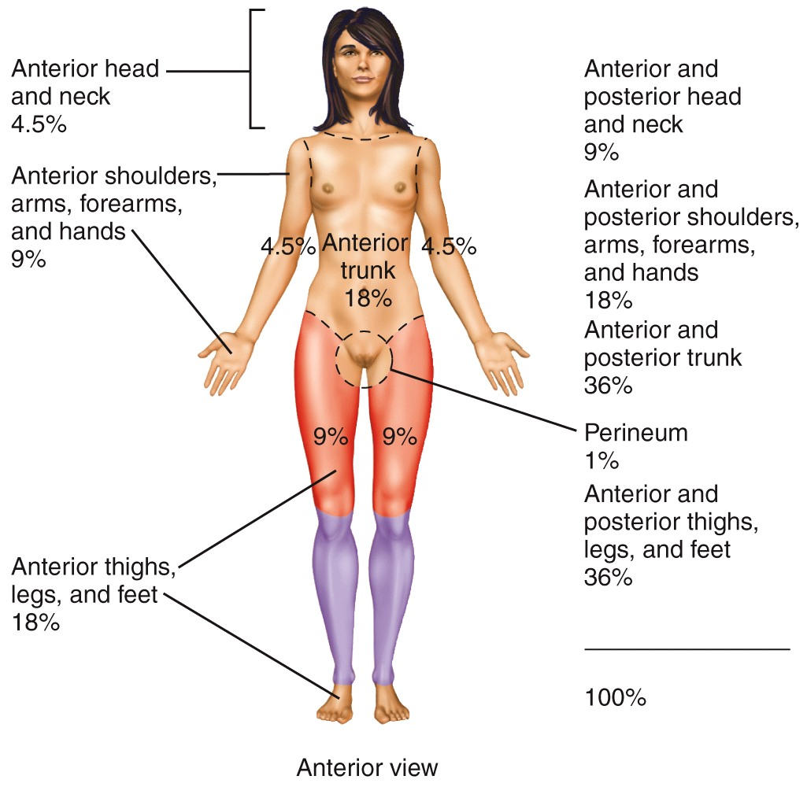
Burns
The rule of nines is used to estimate the surface area of an adult affected by a burn.
Notes:
05_10

